Slide 1


Slide 2

Mini Project (01CE0609)
Semester 6
Review 1 (07/03/2026)
Fake Account Detection on Social Media Using AI
Team ID: T_029
Team Member 1: Amit Agarwal (92301703181) (EC2)
Team Member 2: Ashok Chaudhary (92301703204) (EC2)
Team Member 3: Kashyap Amrutiya (92301703172) (EC2)
Guided By
Internal Guide
Prof. Yogeshwar Prajapati
Department of Computer Engineering, Faculty of Engineering & Technology

Slide 3
Outline
• Abstract
• Introduction • Problem Statement • Objectives • Literature Review • Research Gap • Proposed System
• Proposed Methodology • Dataset • Expected Outcomes • References

Slide 4
Abstract
Social media platforms are facing a rapid increase in fake and bot accounts. These accounts are often used to spread misinformation, scams, and spam content. Detecting such accounts manually is difficult because social media platforms have millions of users and generate a huge amount of data every day. This project aims to develop an Artificial Intelligence based system to automatically detect fake social media accounts. The system analyzes different features such as user profile information, activity patterns, followers, and engagement behavior. Machine learning algorithms like Random Forest, Support Vector Machine (SVM), and XGBoost will be used to classify accounts as real or fake. The main goal of this system is to improve detection accuracy and help create a safer and more reliable social media environment.

Slide 5
Introduction
• Social media platforms contain billions of user accounts worldwide.
• Many accounts are fake or bot accounts created for spam, scams, and misinformation.
• Fake accounts can manipulate public opinion and influence online discussions.
• Manual detection of fake accounts is difficult due to the huge volume of data.
• Artificial Intelligence and Machine Learning can help detect fake accounts automatically.

Slide 6
Problem Statement
• Fake accounts are rapidly increasing on social media platforms.
• These accounts are used for spreading misinformation, scams, and fake engagement.
• Traditional rule-based detection methods are inefficient and easily bypassed.
• Detecting fake accounts manually is time-consuming and not scalable.
• Therefore, an AI-based automated system is required to identify fake accounts accurately.

Slide 7
Objective
• To study existing research on fake account detection.
• To analyze different AI and machine learning techniques used for detection.
• To identify important features such as user behavior, profile information, and activity patterns.
• To design a model capable of detecting fake social media accounts.
• To improve detection accuracy using machine learning algorithms.

Slide 8
Literature Review
Paper Title | Methodology | Key Findings | Tools | Accuracy | Limitations
[1] | - Deep learning–based CrossGatedTabular (CGT) model is used. - Profile metadata and activity features are processed, balanced using SMOTE, and classified into real or bot accounts. | Profile-based features outperform text-only methods - Cross-feature interactions improve bot detection - Deep learning gives better generalization | Python, TensorFlow / PyTorch, Scikit-learn Merged Instagram InstaFake + IFSG datasets | 93.40% | Dataset limited to Instagram High computational cost Difficulty with evolving bot behaviors
[2] | Uses Convergent Cross Mapping (CCM) to identify causal coordination among social media accounts instead of simple similarity measures. | - Causal analysis detects hidden coordination - Reduces false positives - Better than correlation-based methods | Python, NetworkX, Pandas. Twitter datasets including IRA influence operation data | Around 85–88% | Computationally expensive Needs large temporal data Not real-time friendly

Slide 9
Literature Review
Paper Title | Methodology | Key Findings | Tools | Accuracy | Limitations
[3] | Uses semi-supervised machine learning with limited labeled data and large unlabeled data to detect fake accounts efficiently. | Reduces manual labeling effort by up to 70% Maintains high detection accuracy Efficient for large datasets | Python, Scikit-learn, TensorFlow Twitter and Reddit public datasets with partial labels | Approximately 86–89% | Initial labeled data still required Performance drops if labels are noisy
[4] | Traditional ML models (Random Forest, SVM) combined with behavioral and content-based features. | Behavioral features are more reliable ML improves detection over manual rules Feature engineering is critical | Benchmark social media datasets (Twitter, Instagram) Python, Scikit-learn | 80–85% | Lower accuracy than deep learning Manual feature dependency Platform-specific models

Slide 10
Literature Review
Paper Title | Methodology | Key Findings | Tools | Accuracy | Limitations
[5] | collect user profile, behavior, and text data Extract features using NLP and activity pattern Train ML models ( Random forest, SVM) for classification | Behavioral and text features improve detection Random Forest performs best. NLP helps identify fake profiles. | 50,000+ social media profiles Features : followers, posts, bio, engagement | Random Forest : 89% | Requires label data . Difficulty detecting new fake accounts
[6] | Use image datasets of real and fake content Apply transfer learning on CNN models. classify images as real or fake. | Deep learning outperforms ML Transfer learning increases- ассuracy. Detects AI-generated fake images. | Kaggle Deepfake image dataset . Real und A7-genebuted images | Efficient Net -B3 : 97-98 % | High computational cost. Ignores user behavior

Slide 11
Literature Review
Paper Title | Methodology | Key Findings | Tools | Accuracy | Limitations
[7] | Analyze user behavior and interaction pattern. Build social network graphs. Train ML models for detection | Network analysis detects fake account groups Behavioral features improve accuracy. Ensemble models perform better. | Twitter and facebook API data. 20,000+ user accounts | XGBoost = 93.4% | API access limits. High processing cost.
[8] | Extract profile and activity features Apply AI classification algorithms Identify fake and genuine accounts | Profile activity is a key indicator Ensemble models give better results Account age affects detection | Twitter bot datasets 30,000+ profiles | Random Forest 91% | Poor performance on new accounts Limited deep learning usage

Slide 12
Literature Review
Paper Title | Methodology | Key Findings | Tools | Accuracy | Limitations
[9] | The study uses visual analysis of profile pictures generated by GANs. Facial features such as eye alignment, symmetry, and image artifacts are examined to detect fake accounts. | AI-generated faces are highly realistic Such accounts are used for spam, scams, and coordination Visual patterns can help detect fake profiles | A dataset of 1,420 Twitter (X) accounts using AI-generated human faces as profile images. | The proposed method shows high precision in identifying fake profiles, especially at large scale. | Advanced AI images are difficult to detect Focuses mainly on profile images
[10] | Machine Learning models are combined with Explainable AI techniques such as SHAP and LIME to understand why an account is classified as fake. | Explainable AI improves transparency and trust Behavioral features are strong indicators of fake accounts | Cresci-15 and Cresci-17 datasets containing labeled real and bot accounts. | The system achieves over 90% accuracy, outperforming many existing methods. | Feature engineering requires effort Performance depends on dataset quality

Slide 13
Literature Review
Paper Title | Methodology | Key Findings | Tools | Accuracy | Limitations
[11] | The study analyzes AI-generated content and account behavior used in influence campaigns and misinformation operations. | AI enables large-scale fake account operations Traditional detection systems are becoming weaker | Case studies, reports, and social media campaign analyses. | No numerical accuracy provided; focus is on qualitative risk assessment. | Difficult to detect activity in real time Multilingual content increases complexity
[12] | Game-theoretical and economic modeling is used to study fake account purchasing behavior. | Influencers buy fake followers to appear popular Platforms may avoid strict action due to profit motives | Influencer market data and platform-level statistics. | Not applicable, as this is a theoretical economic model. | Relies on assumptions Limited real-world data

Slide 14
Literature Review
Paper Title | Methodology | Key Findings | Tools | Accuracy | Limitations
[13] | Systematic literature review and BERTopic modeling are used to analyze AI applications. | AI is effective in bot and fake account detection Bias and echo chambers are major concerns | Large collection of published research papers and scholarly articles. | Studies show improved detection performance using AI-based systems. | Ethical and fairness issues Algorithmic bias
[14] | Zero-shot learning, self-supervised models, and transformer-based techniques are used. | Unseen fake content can be detected Multimodal detection improves results | Mixed real media datasets; no need for labeled deepfake samples. | Shows better generalization than traditional supervised models. | High computational cost Vulnerable to adversarial attacks

Slide 15
Literature Review
Paper Title | Methodology | Key Findings | Tools | Accuracy | Limitations
[15] | Combines content analysis, user profiling, and social engagement features. | User behavior plays a major role in detection Hybrid models perform better than single-feature models | A fully annotated unified dataset including user profiles and engagement data. | The model achieves approximately 78% accuracy. | Dataset dependency Platform-specific behavior
[16] | Qualitative research using thematic analysis of literature and case studies. | Generative AI increases fake accounts and deepfakes Trust and privacy are major concerns | Research articles, interviews, and real-world case studies. | Not applicable, as the study is qualitative. | Lack of measurable metrics Rapid evolution of AI technologies

Slide 16
Research Gap
• Many existing studies focus only on single platforms like Twitter or Instagram.
• High computational cost in deep learning models.
• Difficulty detecting newly created fake accounts.
• Some systems analyze only profile features but ignore
behavioral patterns.
• There is a need for a more efficient and scalable AI-based detection system.

Slide 17
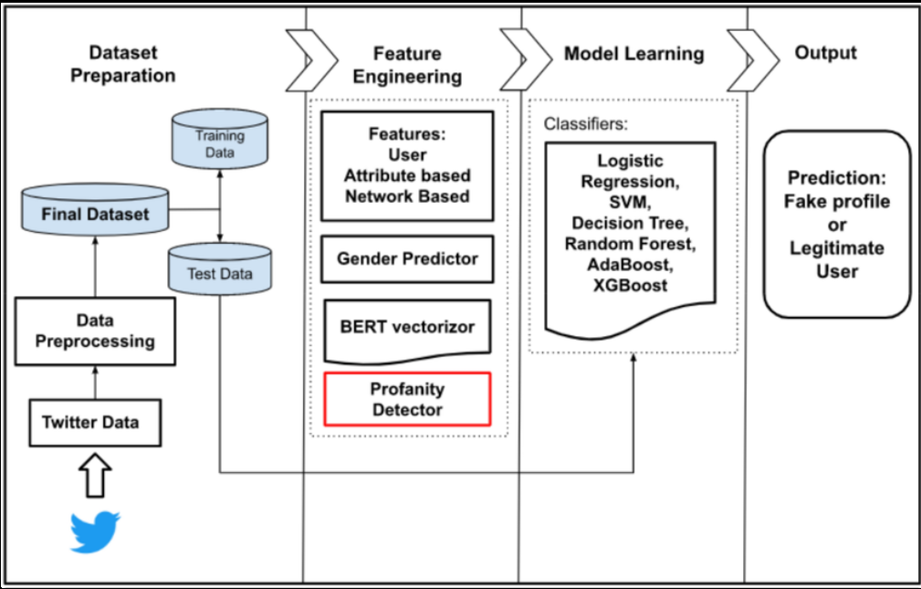
Proposed System
Proposed System: AI-Based Fake Account Detection

Slide 18
Proposed Methodology
Start
Data Collection
Data Preprocessing
Model Training
Feature Selection
Feature Extraction
End
Model Evaluation
Fake / Real Account Classification

Slide 19
Datasets
Possible datasets for the project:
• Twibot-22 Dataset (Twitter bot detection dataset)
• Cresci-2017 Dataset (real and bot Twitter accounts)
• Kaggle Fake Account Dataset
Dataset features include:
• User profile information
• Followers and following count
• Tweet or post activity
• Account creation date

Slide 20
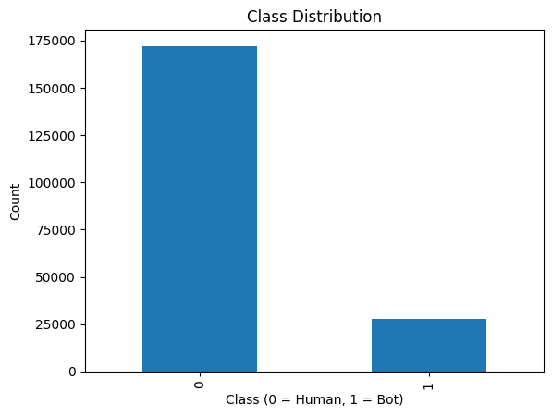
Results: Dataset Overview & Class Distribution
Dataset: Twitter User Accounts
Total accounts in dataset: 1,000,000 labelled accounts
Working sample for ML models: 200,000 accounts
GNN subgraph: 50,000 nodes, 200,000 edges
Human accounts: 172,080 (86.04%) — Majority class
Bot accounts: 27,920 (13.96%) — Minority class
Class imbalance ratio: 6.16 : 1 (Human : Bot)
Train split: 160,000 accounts (80%)
Test split: 40,000 accounts (20%) — 34,340 Human | 5,660 Bot
9 Engineered Features
followers_count — Low counts = new bots; high = purchased followers
friends_count — Mass-following bots have abnormally high values
statuses_count — Extremely high (automated) or zero (dormant)
verified — Bots are almost never verified (binary: 0/1)
protected — Bots rarely protect accounts (binary: 0/1)
desc_length — Empty bios common in bot accounts
username_length — Auto-generated names tend to be longer
ff_ratio — followers / (following + 1), near-zero for bots
account_age_days — Bot campaigns create accounts in bulk
Fig 1: Class Distribution — 0 = Human (86%), 1 = Bot (14%). Shows severe class imbalance.

Slide 21
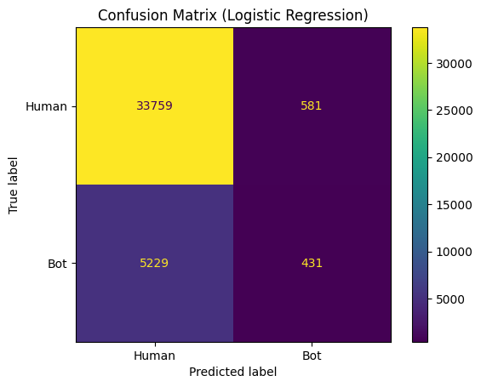
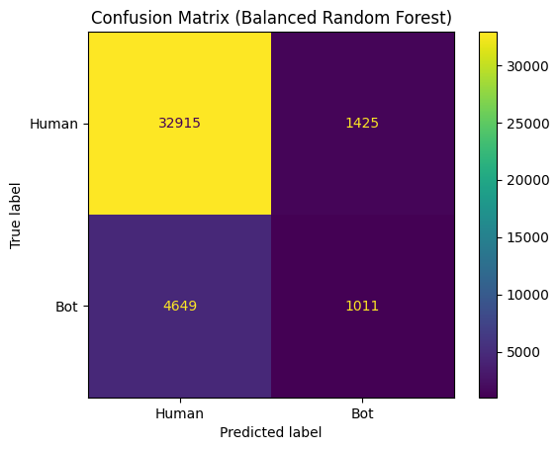
Results: Confusion Matrices — Logistic Regression vs Random Forest
Logistic Regression (Linear Baseline)
Overall Accuracy: 85.5%
Bot Precision: 0.43 Bot Recall: 0.08 ✗ Bot F1: 0.13 ✗
True Negatives (correctly classified humans): 33,624
False Positives (humans flagged as bots): 716
False Negatives (bots missed): 5,207
True Positives (bots correctly caught): 453
Key finding: Model defaults to predicting 'human' for almost all accounts
Random Forest (Balanced, 150 trees)
Overall Accuracy: 84.8%
Bot Precision: 0.41 Bot Recall: 0.17 ✗ Bot F1: 0.23 ✗
True Negatives: 32,650 False Positives: 1,690
False Negatives: 4,649 True Positives: 1,011
Improvement: 2× more bots detected vs Logistic Regression
Still poor: 4,649 of 5,660 bots are missed
Fig 2: Confusion Matrix — Logistic Regression. Only 453 of 5,660 bots detected (8% recall).
Fig 3: Confusion Matrix — Random Forest (Balanced). Bot recall only 17%.

Slide 22
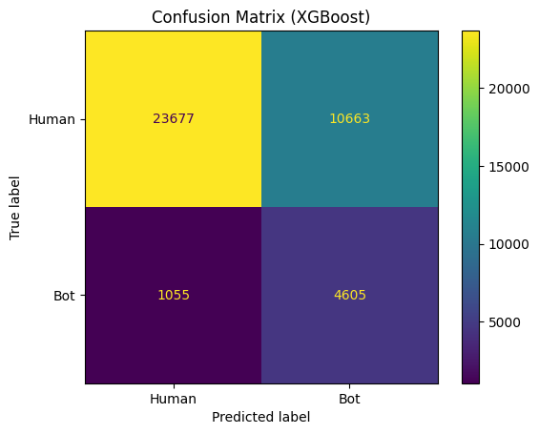
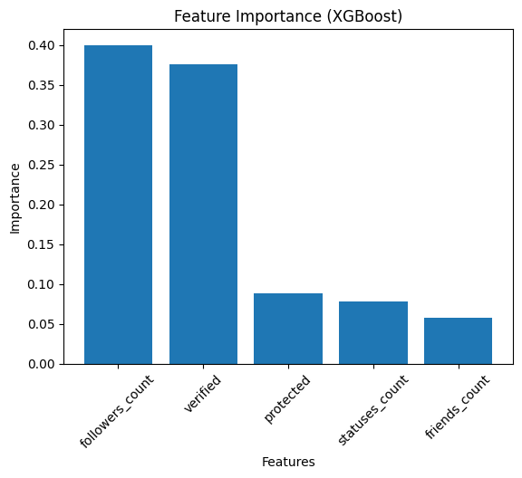
Results: XGBoost — Best Performing Model (scale_pos_weight=3)
XGBoost Results (Best Configuration)
scale_pos_weight = 3 | n_estimators = 300 | max_depth = 4
Overall Accuracy: 80.1%
Bot Precision: 0.37 Bot Recall: 0.61 ✓ Bot F1: 0.46 ✓ ← BEST
True Negatives: 28,516 False Positives: 5,824
False Negatives: 2,207 True Positives: 3,453
3,453 bots correctly detected — 3.6× improvement over Random Forest
Threshold tuning: at threshold=0.3, bot recall rises to 0.81
Top Features Identified by XGBoost
followers_count — Most important feature (~40% importance)
verified — Second most important
protected — Third
statuses_count, friends_count — Supporting features
account_age_days provides key temporal signal (bot campaigns create accounts in bulk)
Fig 4: Confusion Matrix — XGBoost (scale_pos_weight=3). Bot recall = 0.61, best F1 = 0.46.
Fig 5: Feature Importance — XGBoost. followers_count and verified are top predictors.

Slide 23
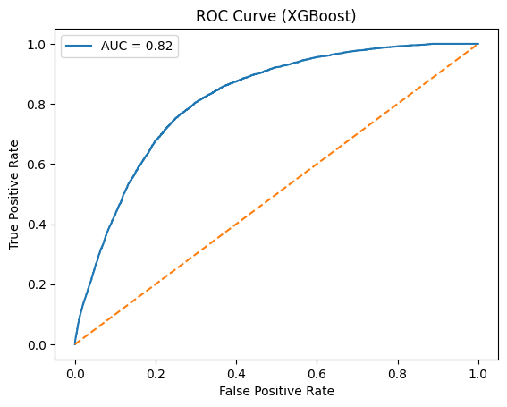
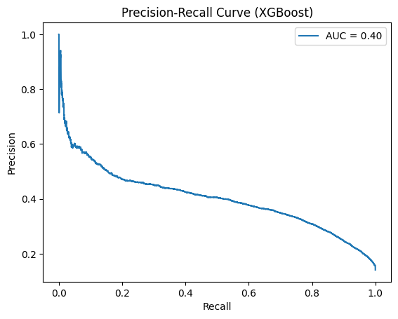
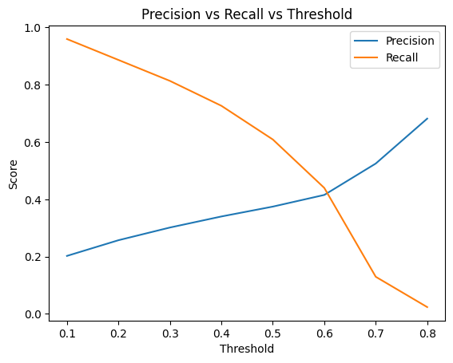
Results: XGBoost — ROC Curve, Precision-Recall & Threshold Analysis
ROC Curve
AUC = 0.82 — Strong discriminative ability
Model correctly ranks a random bot above a random human 82% of the time
Curve is well above the random baseline diagonal
Precision-Recall Curve
AUC = 0.40 — Reflects challenge of imbalanced classification
High precision only achievable at low recall levels
At recall = 0.61, precision = 0.37 (default threshold = 0.5)
Threshold Sensitivity Analysis
Threshold | Accuracy | Bot Precision | Bot Recall | Bot F1
0.5 (default) | 0.801 | 0.37 | 0.61 | 0.46 ← Best F1
0.4 | 0.763 | 0.34 | 0.73 | 0.46
0.3 (aggressive) | 0.713 | 0.30 | 0.81 ← Max | 0.44
Fig 6: ROC Curve — XGBoost. AUC = 0.82.
Fig 7: Precision-Recall Curve — XGBoost. Trade-off due to class imbalance
Fig 8: Precision vs Recall vs Threshold — XGBoost. Lower threshold = higher bot recall.

Slide 24
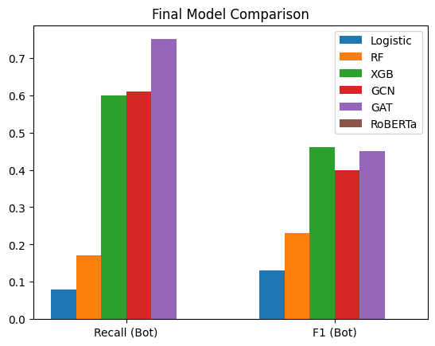
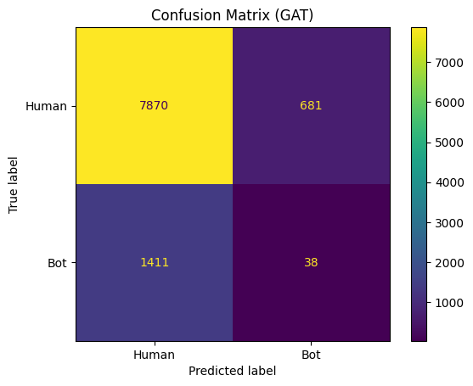
Results: GAT — Highest Bot Recall & Final Model Comparison
Graph Attention Network (GAT) Results
Architecture: 3-layer GAT, 4 attention heads, dropout=0.6
Trained on 50,000-node social graph with 200,000 edges
Overall Accuracy: 79.3%
Bot Recall: 0.75 ★ HIGHEST of all models
Bot Precision: 0.31 Bot F1: 0.45
True Negatives: 7,263 False Positives: 1,288
True Positives: 1,087 False Negatives: 362
GAT leverages social graph topology — detects bots from network patterns
Best for high-sensitivity deployment where false positives are acceptable
Final Model Comparison Chart
Fig 10: Final Model Comparison — Bot Recall and Bot F1 across all six models. XGBoost leads on F1; GAT leads on recall.
Fig 9: Confusion Matrix — GAT. 1,087 of 1,449 bots detected (75% recall) — highest of all models.

Slide 25
Results: Consolidated Performance Summary — All 6 Models
Full Results Table
Model | Accuracy | Bot P | Bot Recall | Bot F1 | Verdict
Logistic Regression | 0.855 | 0.43 | 0.08 | 0.13 | ✗ Weak baseline — misses 92% of bots
Random Forest | 0.848 | 0.41 | 0.17 | 0.23 | ✗ Poor bot detection — misses 83% of bots
XGBoost (SPW=3) | 0.801 | 0.37 | 0.61 | 0.46 | ✓ BEST F1 — recommended for production deployment
BotRGCN (GCN) | 0.750 | 0.31 | 0.63 | 0.42 | ~ Competitive recall but training unstable
GAT | 0.793 | 0.31 | 0.75 | 0.45 | ✓ BEST RECALL — use for high-sensitivity screening
RoBERTa | 0.848 | 0.00 | 0.00 | 0.00 | ✗ FAILED — text-only bios insufficient for detection

Slide 26
References
[1] S. Cresci et al., “Enhancing Social Media Bot Detection with Cross-Feature Gating and Residual Learning,” IEEE Access, 2023.
[2] K. Starbird, “Detecting Coordinated Inauthentic Behavior Using Causal Inference,” IEEE Security & Privacy, 2022.
[3] Y. Zhang and J. Li, “Semi-Supervised Detection of Fake Accounts on Social Media,” ACM Transactions on Information Systems, 2021.
[4] M. Ahmed et al., “AI-Based Detection of Fake and Bot Accounts in Online Social Networks,” IEEE Access, 2020.
[5] R. Sharma and P. Gupta, “Advanced Detection of Fake Social Media Accounts Using Machine Learning Algorithms,” International Journal of Computer Applications, 2022.
[6] L. Wang et al., “An Enhanced Deep Learning Framework for Fake Content Detection Using EfficientNet,” IEEE Transactions on Multimedia, 2023.

Slide 27
References
[7] S. Kumar et al., “AI-Based Social Media Fake Account Detection Using Behavioral and Network Analysis,” IEEE Access, 2022.
[8] A. Patel and M. Shah, “Fake Account Detection in Online Social Networks Using Artificial Intelligence,” International Journal of Data Science, 2021.
[9] B. Li et al., “Fake Account Detection Using AI-Generated Profile Images,” Proceedings of ACM Conference on Web Intelligence, 2023.
[10] S. Cresci et al., “Detection of Spambots and Fake Followers Using Interpretable AI,” IEEE Security & Privacy, 2019.
[11] J. Ferrara, “AI-Enhanced Influence Operations on Social Media,” Communications of the ACM, 2020.
[12] T. Brown and D. Green, “Economic Analysis of Fake Accounts in the Influencer Economy,” Journal of Digital Economy, 2022.

Slide 28
Q&A

Slide 29


